Slide 2
Run the Race God Has Set Before You
Ecclesiastes 9:11; Isaiah 59:1-8; Romans 9:15-16

Slide 3
1. Accept that life is unpredictable

Slide 4
1. Accept that life is unpredictable Ecclesiastes 9:11
¹¹ I again saw under the sun that the race is not to the swift and the battle is not to the warriors, and neither is bread to the wise nor wealth to the discerning nor favor to men of ability; for time and chance overtake them all.

Slide 5
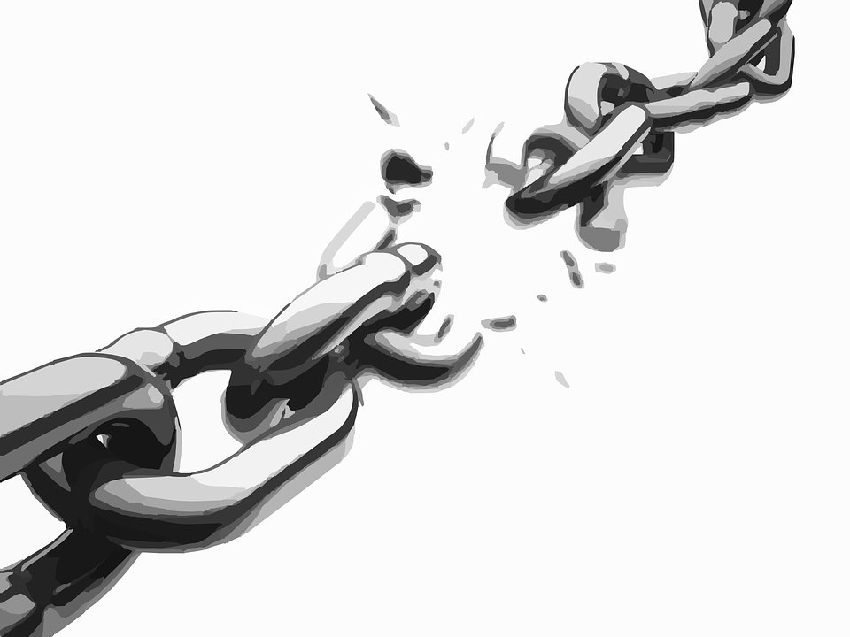
2. Stop running your sinful race

Slide 6
2. Stop running your sinful race Isaiah 59:1-8
¹ Behold, the Lord’s hand is not so short That it cannot save; Nor is His ear so dull That it cannot hear.

Slide 7
² But your iniquities have made a separation between you and your God, And your sins have hidden His face from you so that He does not hear.
³ For your hands are defiled with blood And your fingers with iniquity; Your lips have spoken falsehood, Your tongue mutters wickedness.

Slide 8
⁴ No one sues righteously and no one pleads honestly. They trust in confusion and speak lies; They conceive mischief and bring forth iniquity.
⁵ They hatch adders’ eggs and weave the spider’s web; He who eats of their eggs dies, And from that which is crushed a snake breaks forth.

Slide 9
⁶ Their webs will not become clothing, Nor will they cover themselves with their works; Their works are works of iniquity, And an act of violence is in their hands.
⁷ Their feet run to evil, And they hasten to shed innocent blood; Their thoughts are thoughts of iniquity, Devastation and destruction are in their highways.

Slide 10
⁸ They do not know the way of peace, And there is no justice in their tracks; They have made their paths crooked, Whoever treads on them does not know peace.

Slide 11
3. God’s mercy is not earned

Slide 12
3. God’s mercy is not earned Romans 9:15-16
¹⁵ For He says to Moses, “I will have mercy on whom I have mercy, and I will have compassion on whom I have compassion.”
¹⁶ So then it does not depend on the man who wills or the man who runs, but on God who has mercy.

