Slide 1

The First Four Seals
Revelation 6:1-8

Slide 2
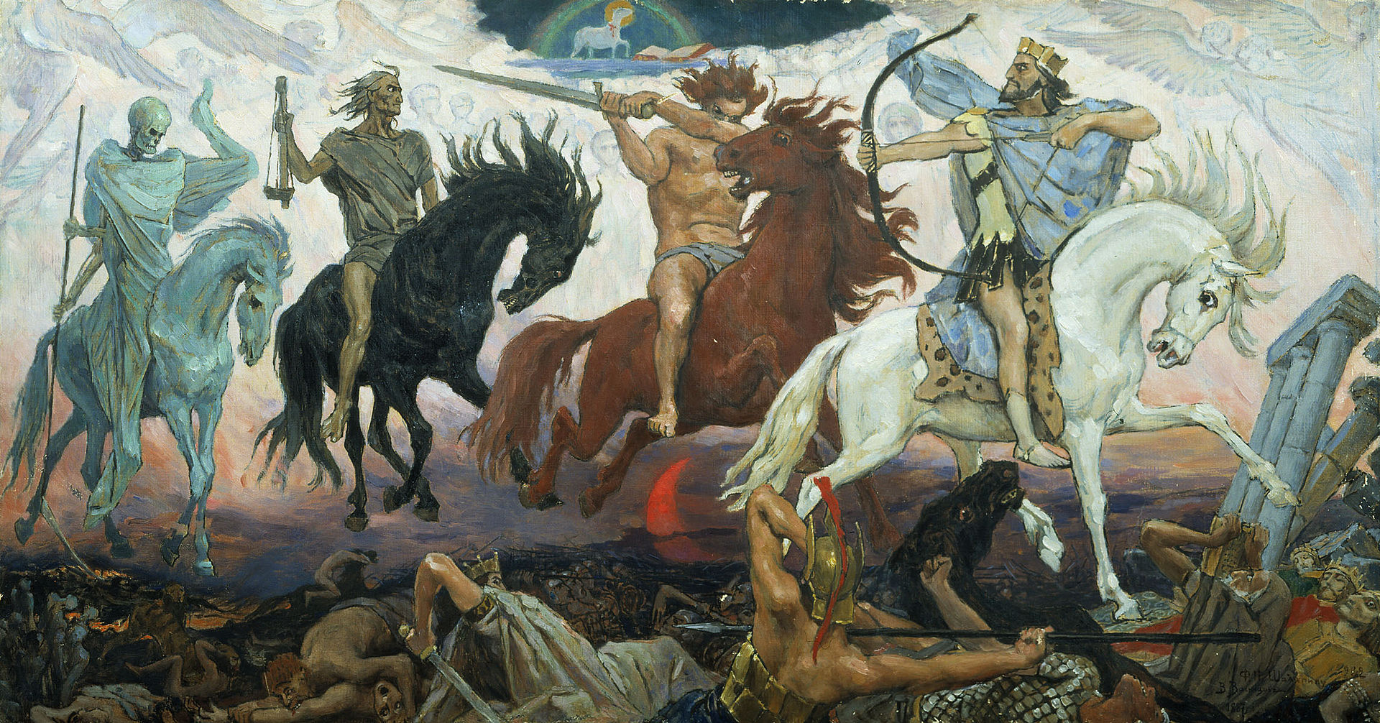
Laodicea
(Rev 3:14-22)

Slide 3
The first seal (Rev 6:1-2)
¹ Then I saw when the Lamb broke one of the seven seals, and I heard one of the four living creatures saying as with a voice of thunder, “Come!”
² I looked, and behold, a white horse, and the one who sat on it had a bow; and a crown was given to him, and he went out conquering and to conquer.

Slide 4
The Second seal (Rev 6:3-4)
³ When He broke the second seal, I heard the second living creature saying, “Come!”
⁴ And another, a red horse, went out; and to him who sat on it, it was granted to take peace from the earth, and that people would kill one another; and a large sword was given to him.

Slide 5
The third seal
⁵ When He broke the third seal, I heard the third living creature saying, “Come!” I looked, and behold, a black horse, and the one who sat on it had a pair of scales in his hand.

Slide 6
⁶ And I heard something like a voice in the center of the four living creatures saying, “A quart of wheat for a denarius, and three quarts of barley for a denarius; and do not damage the oil and the wine.”

Slide 7
The Fourth seal
⁷ When the Lamb broke the fourth seal, I heard the voice of the fourth living creature saying, “Come!”

Slide 8
⁸ I looked, and behold, an ashen horse; and the one who sat on it had the name Death, and Hades was following with him. Authority was given to them over a fourth of the earth, to kill with sword, and famine, and plague, and by the wild animals of the earth.

